Slide 1




DIGITAL AGENCY
We Build Bold Digital Experiences
A full-service creative studio helping brands grow through design, technology, and smart marketing — all under one roof.
Web Design • Graphic Design • Digital Marketing • AI Tools • Social Media

Slide 2

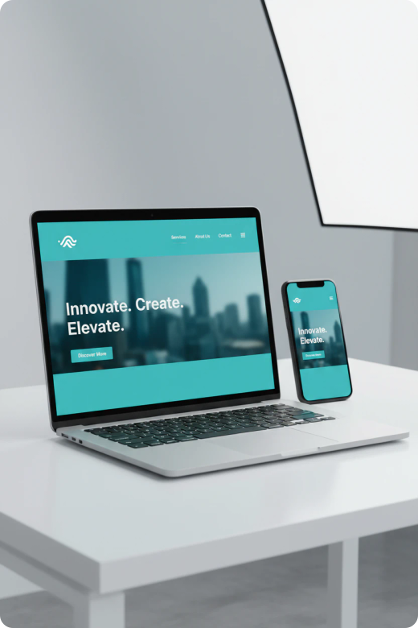
01 / SERVICE
Web Design
Fast, responsive websites designed to convert visitors into customers — built around your brand and your goals.
User-first approach — research, wireframes, and testing
Built with React, Next.js & modern web standards
Mobile-responsive and SEO-ready by default
Fast load speeds that improve conversions
Ongoing support and easy content updates

Slide 3

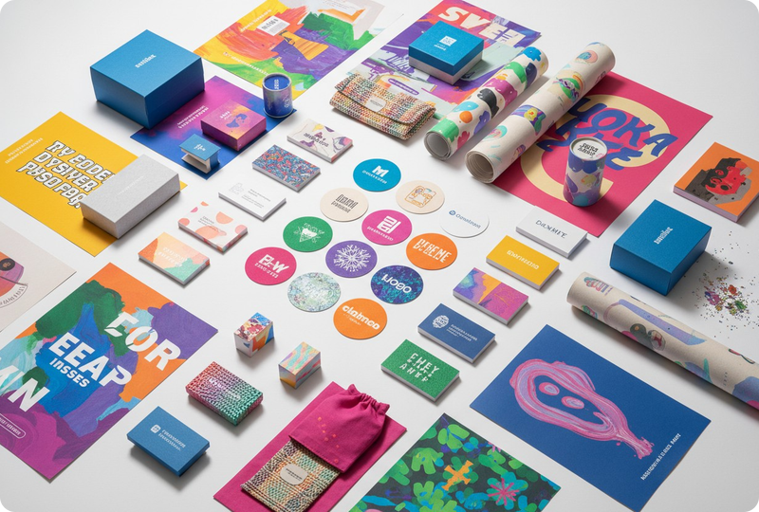
02 / SERVICE
Graphic Design
Visual identity that makes your brand unforgettable — from logos to full brand systems.
Logos, brand identity & style guides
Social graphics, ads & print collateral
Packaging and marketing materials
Fully customizable to your vision
Portfolio spanning startups to enterprise

Slide 4

03 / SERVICE
Digital Marketing
Data-driven campaigns that put your brand in front of the right people at the right time.
SEO & paid search (Google, Bing)
Social & display advertising
Email marketing & automation
Content strategy & analytics
Transparent, measurable ROI reporting
+240%
Average traffic growth for clients within the first 6 months of a campaign.

Slide 5



04 / SERVICE
Mastering AI Tools
We put cutting-edge AI to work — accelerating output, sparking innovation, and cutting costs.
AI-assisted content & copy generation
Automated design and image creation
Predictive analytics & smart targeting
Chatbots and workflow automation
Faster delivery without cutting quality

Slide 6
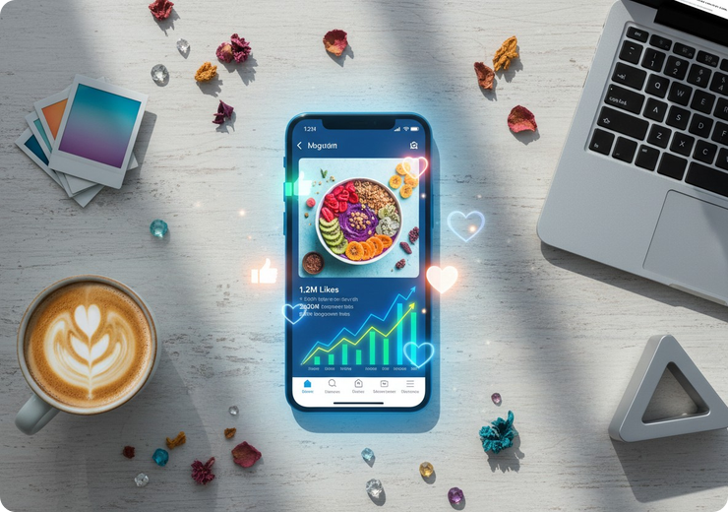
05 / SERVICE
Social Media Management
We grow and nurture your online communities so your brand stays top of mind.
Content planning & daily posting
Community engagement & moderation
Instagram, Facebook, LinkedIn, TikTok, X
Influencer & campaign coordination
Monthly growth & visibility reporting

Slide 7



WHY CHOOSE US
One Team. Every Advantage.
Full-Service
Results-Driven
Future-Ready
Design, marketing, and AI expertise under one roof — no juggling vendors.
Every decision is backed by data and measured against your goals.
We adopt AI and new tech early so you always stay ahead of competitors.
“They transformed our online presence — traffic doubled and our brand finally feels premium.”
— Sarah M., Founder & CEO, Bloom Retail

Slide 8



LET'S TALK
Ready to Grow Your Brand?
Book a free 30-minute consultation and let's map out your next move — no strings attached.
Book Your Free Call
abdiolani881@gmail.com • +251989247347
https://abdidigitaldesigner.com/

