Slide 1



DIGITAL SKILLS SERIES
Definition of Digital Service
Digital services are online-based solutions that help businesses and people connect, communicate, and grow in an increasingly digital world.

Slide 2
02 / WEB DESIGN
The Meaning of Web Design
Web design is the process of creating the appearance and structure of a website — deciding how it looks, how it is organized, and how visitors move through it.
KEY CONSIDERATIONS BY A WEB DESIGNER
Purpose and goals of the website
Target audience and their needs
Clear structure and easy navigation
Visual identity: colors, fonts, and imagery
Speed, accessibility, and mobile responsiveness

Slide 3

03 / WEB DESIGN EXAMPLE
A Restaurant Website
Every part of the design works together to make visitors hungry and help them book a table quickly.
Layout — a clean structure that guides the eye
Navigation — easy access to menu, hours, location
Colors — warm tones that reflect the brand
Typography — readable, appetizing fonts
User experience — smooth booking and ordering

Slide 4


04 / SKILLS
Skills Used in Web Design
Page layout
Color selection
Typography
User experience design
Basic HTML and CSS
Responsive design
Image editing
Website builders
Together, these skills let a designer turn an idea into a beautiful, working website that performs well on every screen.

Slide 5
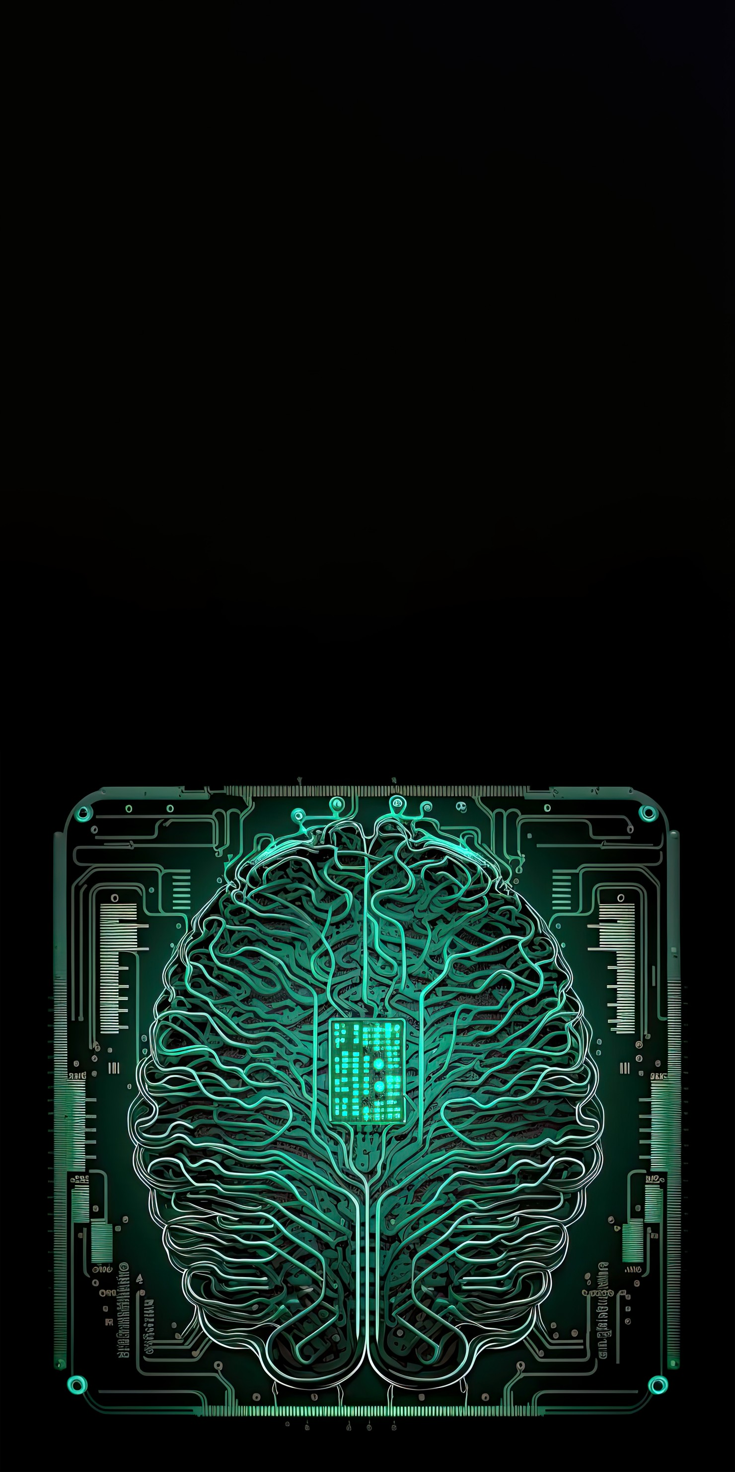

05 / AI TOOLS
Mastering AI Tools
Mastering AI tools means learning to guide them well. A prompt is the instruction you give the tool — the clearer it is, the better the result.
WEAK PROMPT
"Write about marketing."
STRONG PROMPT
"Write a 100-word social media post promoting a new coffee shop, in a friendly tone, aimed at young students."

Slide 6

06 / AI TOOLS
Uses and Warnings of AI Tools
WHAT AI TOOLS CAN DO
Writing and editing content
Creating graphics and images
Research and gathering information
Data analysis and summaries
Automating repetitive tasks
⚠ IMPORTANT WARNING
Always review AI-generated content before using it. AI can make mistakes, invent facts, or miss context. Check accuracy, add your own judgment, and never publish without a human review.

Slide 7

07 / GRAPHIC DESIGN
Graphic Design
Graphic design is the art of combining images, text, and color to communicate a message. Example: designing invitations, posters, and banners for a graduation ceremony.
KEY PRINCIPLES
Balance
Contrast
Alignment
Repetition
Proximity
Hierarchy

Slide 8

08 / GRAPHIC DESIGN
Types and Differences of Graphic Design
TYPES OF GRAPHIC DESIGN
Branding and logo design
Marketing and advertising design
Packaging design
Publication and editorial design
Motion and social media graphics
GRAPHIC vs WEB DESIGN
Graphic design creates visuals that communicate a message — often for print or static media. Web design focuses on building interactive websites that people navigate and use online. Graphic design is about the look; web design is about the look plus how it works.

Slide 9


09 / SOCIAL MEDIA
Social Media Management
Social media management is the work of planning, running, and growing a brand's presence across social platforms.
RESPONSIBILITIES
Content planning, creation, and publishing
Community management and engagement
Monitoring performance and reporting
EXAMPLE WEEKLY PLAN
Mon: Tip post • Wed: Product feature
Fri: Behind-the-scenes • Sun: Poll or Q&A

Slide 10


10 / DIGITAL MARKETING
Digital Marketing
Digital marketing is promoting products and services through online channels to reach and engage the right audience.
MAIN TYPES
Social media marketing
Search engine optimization (SEO)
Email marketing
Content marketing
Online advertising
Influencer and website marketing
COMMON MARKETING PROCESS
1. Set clear goals
2. Understand the audience
3. Choose the right channels
4. Create and publish content
5. Measure, analyze, and improve

