Slide 1



Home
About
Service
Your Company
Business Template
A comprehensive guide to strategy, growth, and success for your business endeavors.
Presented by
ABDI DIGITAL DESIGNER

Slide 2

Home
About
Services
Your company
Our Vision
Abdi is dedicated to empowering businesses with innovative solutions that drive sustainable growth. We envision a future where every organization, regardless of size, has access to the strategic tools and expertise needed to thrive in an ever-evolving marketplace. Our commitment to excellence guides everything we do.
Value Proposition
Executive Summary
We serve ambitious small to mid-sized businesses seeking transformative growth. Our core value lies in delivering tailored consulting services that combine industry expertise with actionable insights. By partnering with us, clients gain a competitive edge through streamlined operations, enhanced market positioning, and data-driven decision making.

Slide 3

Home
About
Service
Your company
Our Solution
01
02
03
Operational Efficiency
Seamless Scalability
Sustainable Growth
Streamline your workflows and reduce operational costs with our intelligent automation tools. Our solutions eliminate redundant processes, optimize resource allocation, and deliver measurable productivity gains across your entire organization.
Grow your business without growing pains. Our flexible infrastructure adapts to your needs, whether you're expanding to new markets, increasing capacity, or adding new service lines. Scale up or down with confidence and agility.
Build a foundation for long-term success with strategies that balance profitability and responsibility. Our approach ensures your growth is not only rapid but also resilient, environmentally conscious, and aligned with evolving market demands.

Slide 4



Home
About
Service
Data Analytics
Cloud Services
Transform raw data into actionable business intelligence. Our advanced analytics platform provides real-time insights, predictive modeling, and comprehensive reporting to drive informed decision-making across your organization.
Secure, scalable cloud infrastructure designed for modern businesses. Our enterprise-grade solutions ensure 99.9% uptime, seamless data migration, and robust security protocols to protect your critical business assets.
Operational Excellence
Customer Experience
Business Solutions
Streamline your operations with automated workflows and intelligent process management. Reduce costs, eliminate bottlenecks, and achieve greater efficiency through our proven operational frameworks and tools.
Deliver exceptional customer journeys through personalized touchpoints and responsive support. Our integrated CRM systems and analytics help you understand and exceed customer expectations at every interaction.

Slide 5

Home
About
Service
Your company
05
02
Business Model
Customer Needs
Revenue Streams
Modern businesses face increasing complexity in operations, data management, and market competition. They need streamlined solutions that reduce operational overhead while improving efficiency. Our target customers seek reliable partners who understand their industry challenges and can deliver measurable results with minimal disruption to existing workflows.
Our diversified revenue model includes subscription-based services, project-based consulting fees, and licensing arrangements. Enterprise clients benefit from annual contracts with tiered pricing based on usage and support levels. Additional revenue comes from training programs, implementation services, and ongoing maintenance agreements.

Slide 6
Home
About
Service
Your company
Roadmap 2026
Q1
Q2
Q3
Q4
Research & Discovery
Implementation & Execution
Performance Review
Strategic Planning
Conduct comprehensive market analysis, identify target audience segments, and gather competitive intelligence. Define key business objectives and establish baseline metrics for success measurement.
Develop actionable business strategies aligned with organizational goals. Create detailed project timelines, allocate resources effectively, and establish clear milestones for tracking progress.
Deploy strategic initiatives across all business units. Coordinate cross-functional teams, manage stakeholder communications, and ensure seamless integration of new processes and systems.
Analyze results against established KPIs and benchmarks. Generate comprehensive reports, identify optimization opportunities, and implement continuous improvement strategies for sustained growth.

Slide 7
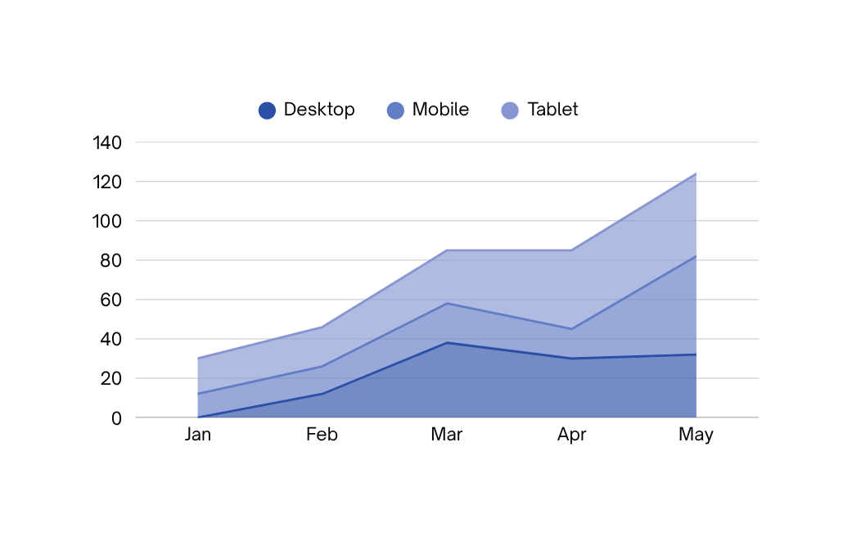

Home
About
Service
Your company
Target Audience
Our primary market consists of mid-size enterprises seeking scalable solutions. With over 50,000 potential clients in our target segment, we've identified strong demand for streamlined business operations and digital transformation services.
Growth Trends
Revenue has grown 47% year-over-year with customer acquisition up 35%. Our retention rate stands at 92%, demonstrating strong product-market fit. Forecasts indicate continued momentum with projected 60% growth in the coming fiscal year.
Market Opportunity

Slide 8
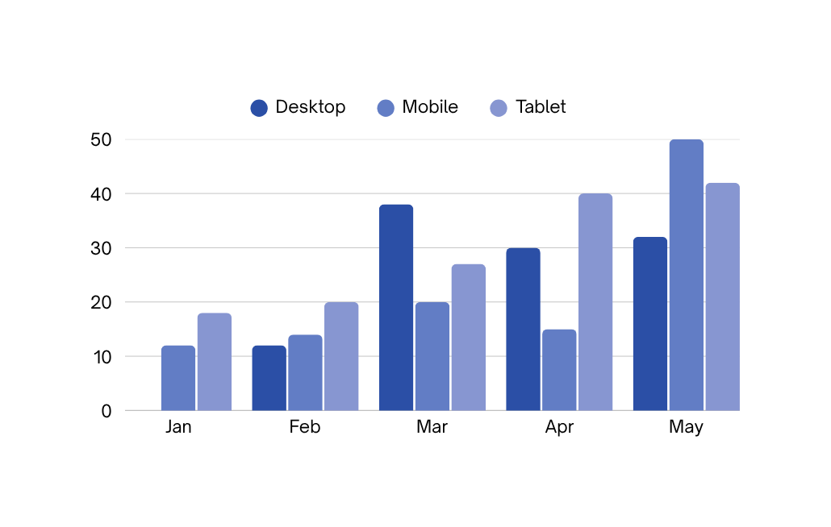
Home
About
Service
Your company
Revenue Target
Our projected annual revenue target is $2.4M for Year 1, scaling to $8.5M by Year 3. Primary revenue streams include subscription services, consulting fees, and enterprise licensing agreements.
Profit Margin
We project gross margins of 65% with net profit margins reaching 18% by Year 2. Key cost drivers include personnel, technology infrastructure, and customer acquisition, with operational efficiency improving as we scale.
Financial Projections

Slide 9
Home
About
Service
Your company
Marketing Strategy
Immersive Content
Community Building
Captivate your audience with compelling storytelling, interactive experiences, and multimedia content that drives engagement and positions your brand as an industry leader.
Build lasting relationships with your audience through targeted engagement campaigns, social media management, and loyalty programs that turn customers into brand advocates.

Slide 10
Home
About
Service
Hanover & Tyke
Conclusion
The business case presented demonstrates a clear path to sustainable growth and market leadership. Our strategic approach combines proven methodologies with innovative solutions tailored to your specific needs. With a strong foundation in place and measurable milestones defined, we are positioned to deliver exceptional results. The opportunity before us represents not just incremental improvement, but transformational change that will define the next chapter of success.
Moving forward, we recommend immediate engagement to capitalize on current market conditions and competitive advantages. Our team stands ready to begin implementation with a phased approach that minimizes risk while maximizing returns. The time to act is now—every day of delay represents missed opportunity. We look forward to partnering with you on this journey and are confident that together, we will achieve outstanding outcomes that exceed expectations.

Slide 11





Home
About
Services
Your company
Thank You
2026
We appreciate your time and interest in our business solutions. Let's connect to discuss how we can help drive your success forward.
+251989247347
https://abdidigitaldesigner.com
abdiolani881@gmail.com
Presented by
Addis Abeba,Ethiopia Ethiopia
ABDI DIGITAL DESIGNER

